Slide 1

HSBCnet Overview
Prepared by: HSBCnet IT
Date: 2014

Slide 2
About Presenter
Rajendran Murthy
Head of Business Analysis practice - eChannels

Slide 3
Objective
Get familiar with HSBCnet, understand BIG picture about HSBCnet
Ability to relate with HSBCnet tools.

Slide 4



Big Picture
International Trade
Buying and selling of goods and services across geographies.
International Payments
Money transaction across geographies for personal and business use.
Banks facilitate the trade and payment transaction through their channels, products and services.

Slide 5

















Online banking for Business
In a business corporates have to manage Receivables and Payables. They trade, research, analyze and comply with governance. To run their business efficiently they require a robust banking solution with effective entitlement .
Supplier
Payables
Information
USER MANAGEMENT
Market, Research, Compliance
Logistics
CORPORATE
Receivables
Distribution
Online banking solutions are designed to meets business needs of corporate and enables them to manage their finances efficiently and conduct their business smoothly. A User Management tool will enable the corporates administer & control business.

Slide 6


HSBCnet & features
What is HSBCnet ?
HSBCnet is multi-functional, secure online platform for corporates that meets their global financial needs.
KEY FEATURES
MANAGE
PAYMENTS & CASH FLOW
________________________
Payment templates
Local and cross-border payments.
Collection of cheques
Secure payment through authorization
Trade &
Payments
Cash Management
Global Markets & Securities
ACCESS
CUSTOMER REPORTS
________________________
Real time information of accounts
Online reports, statements
Effective cash flow management
Customized reports
ADMINISTER USERS
_______________________
Flexible administration & Control
Streamline internal process
Improve operational efficiency
Personalize views
Manage users
GLOBAL BANKING
& SECURITIES TOOLS
_______________________
Online trading, analysis and research
Cross product valuation
Reports
Access to foreign exchange rates
TRADE & SUPPLY CHAIN
TOOLS
_______________________
Initiate trade
Access trade account information
Apply for documentary credit
View bills & control trade payments
Receive advices
Check available credit and balance

Slide 7
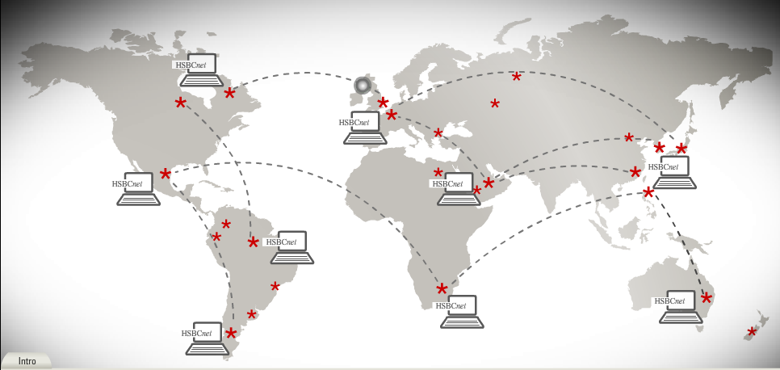
Highlights of HSBCnet
Available in over 73 countries and territories
One easy to use interface
Customizable
Real time and intra day access
Comprehensive and global
Language choice
Multi functional secure
Over 65000 customers and
400000 users
12.5 million payment transactions a month

Slide 8

E2E picture
Front End/PL
Middleware
Backend Processing
Middleware
Back office Systems
GPS
SHEX F/E
RPS
GE F/E
MQ
UK EBC
Staff User
PCF
MQ
C:D
HK EBC
US EBC
HUB
ESP
C:D
SHEX B/E
GE B/E
HSBCnet Payments
GSI
OLAM
GSI
TRADES
CONNECT
AI/BTR
RCI
AI/BTR
PAYMENT
R2DS
WDA/DDA/TDA
HSBCnet Customer
File Upload
REPORTING
GMG
R2DS
Report File Download
Third party destination
OBS

Slide 9
HSBCNET TOOLS
SHEX
GLOBAL ENTITLEMENT
REPORTING
PAYMENTS
CONNECT
ALERT TOOLS

Slide 10

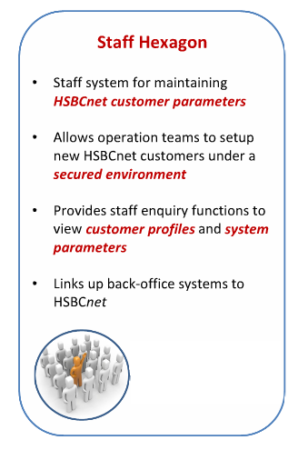
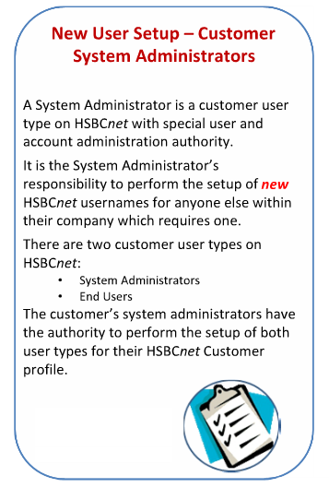
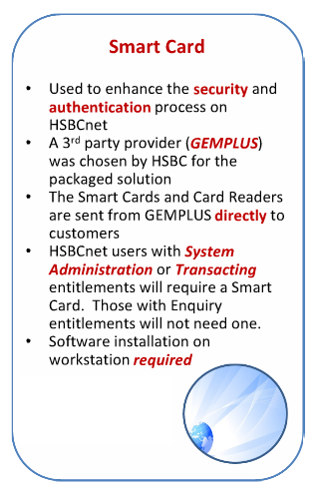
User and Account setup

Slide 11
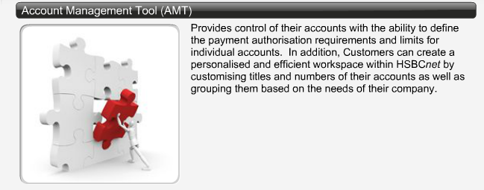
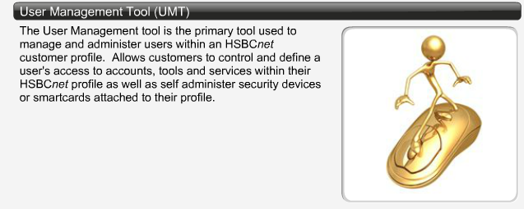
User and Account Management tools

Slide 12
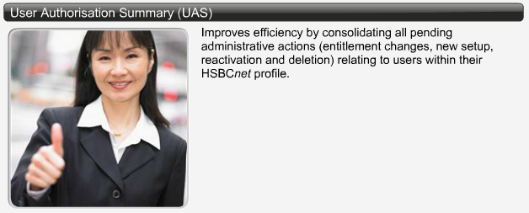
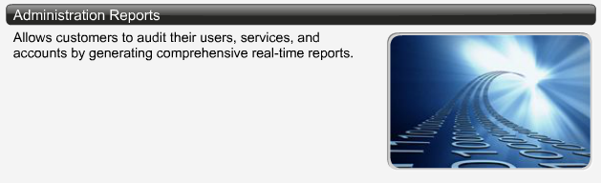
User and Account Management tools

Slide 13
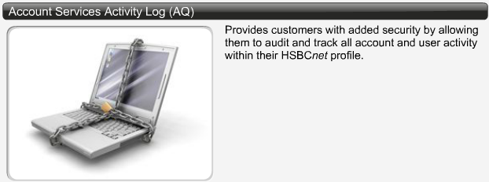
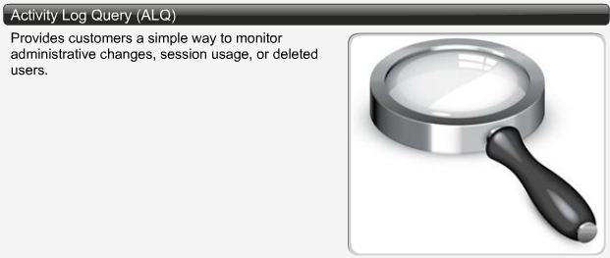
User and Account Management tools

Slide 14
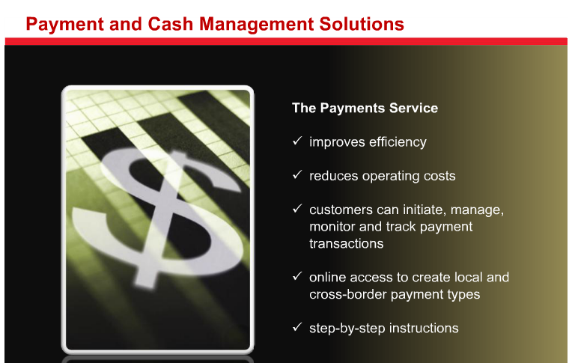
Payment and Cash Management Solutions

Slide 15
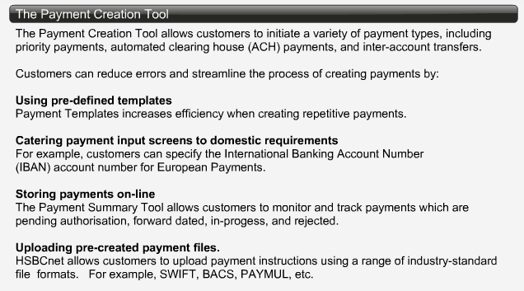
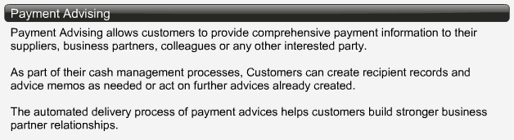
Payment and Cash Management solutions

Slide 16
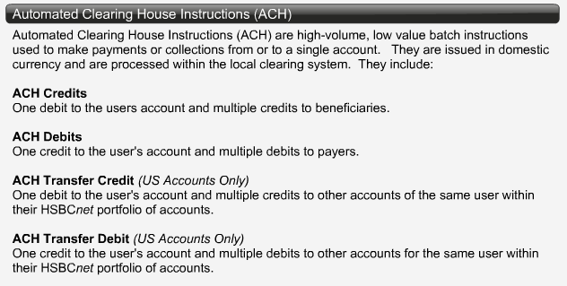
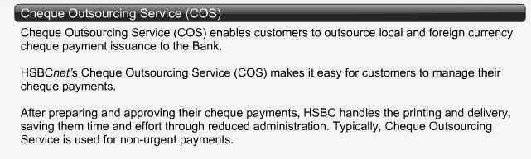

Slide 17
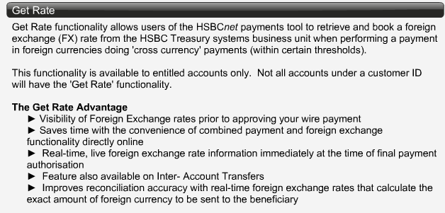
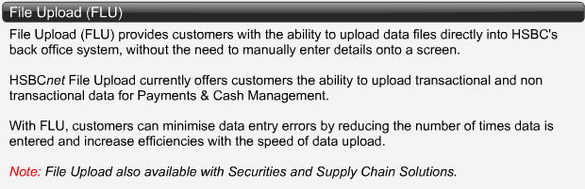

Slide 18
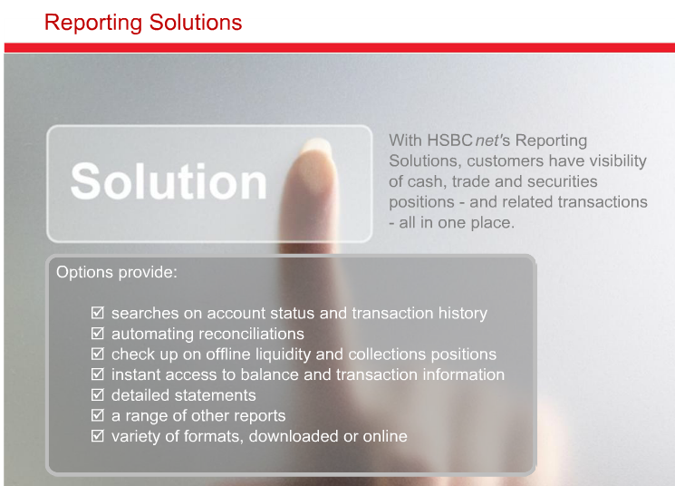
Reporting Solutions

Slide 19
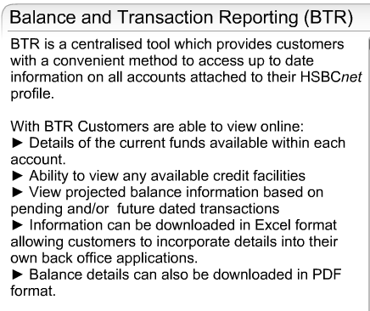
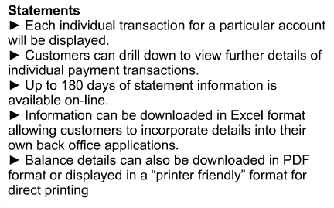
Reporting Solution

Slide 20
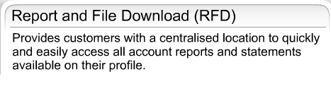
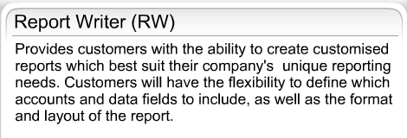
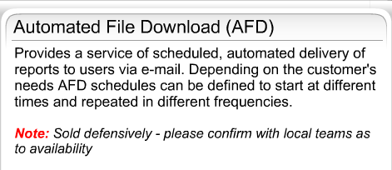
Reporting Solution

Slide 21
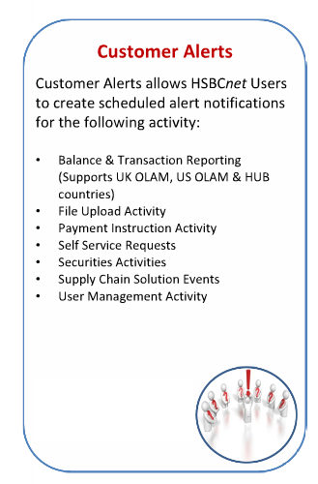
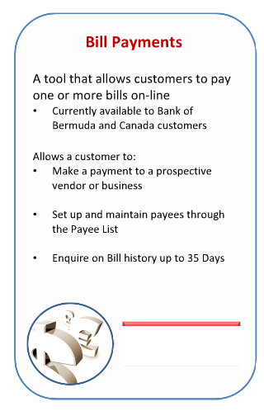
Alerts & Bill Payments

Slide 22
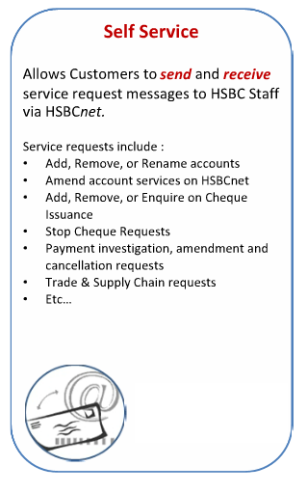
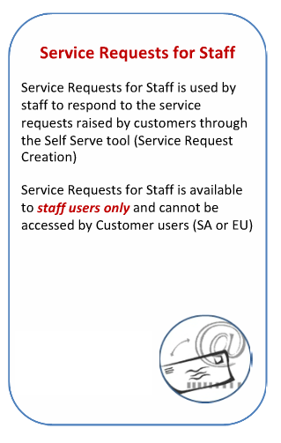
Self Service

